Slide 1
Virtual Classroom Scavenger Hunt
Are you up for a challenge?
Click through the presentation and see if you can locate various objects throughout our virtual classroom!!

Slide 2
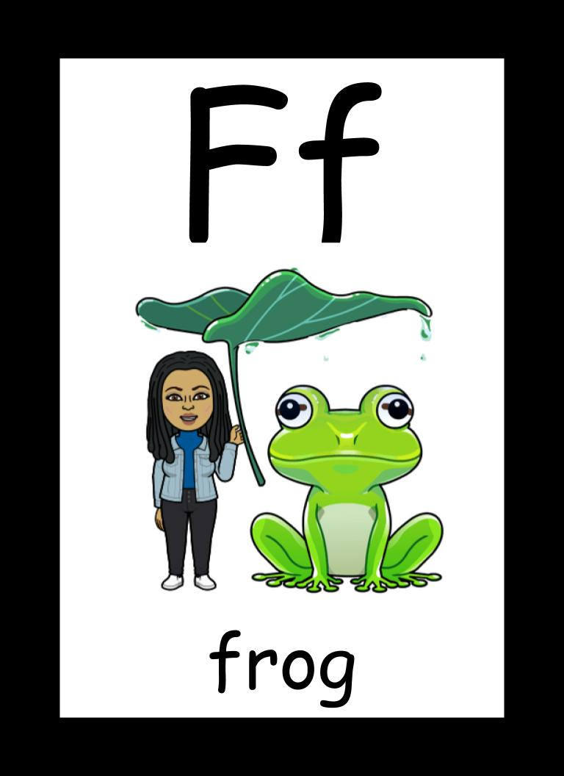
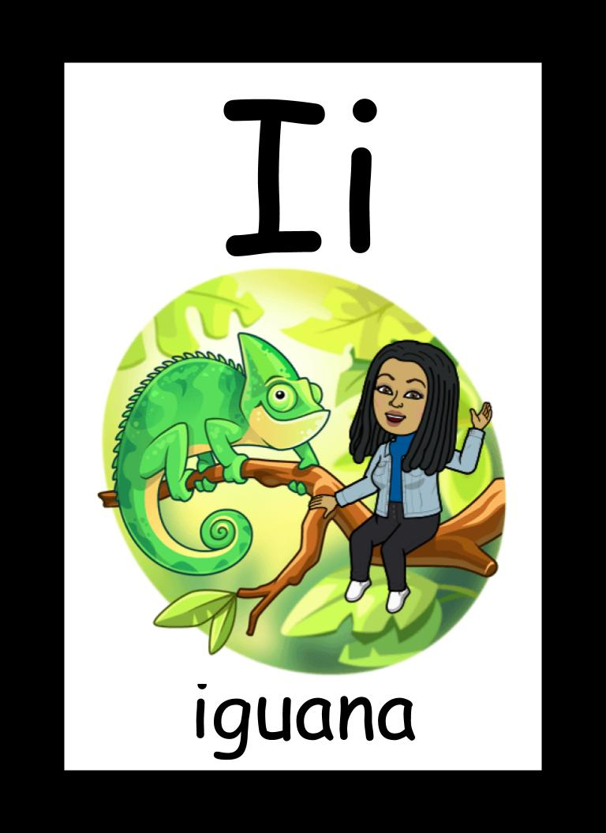
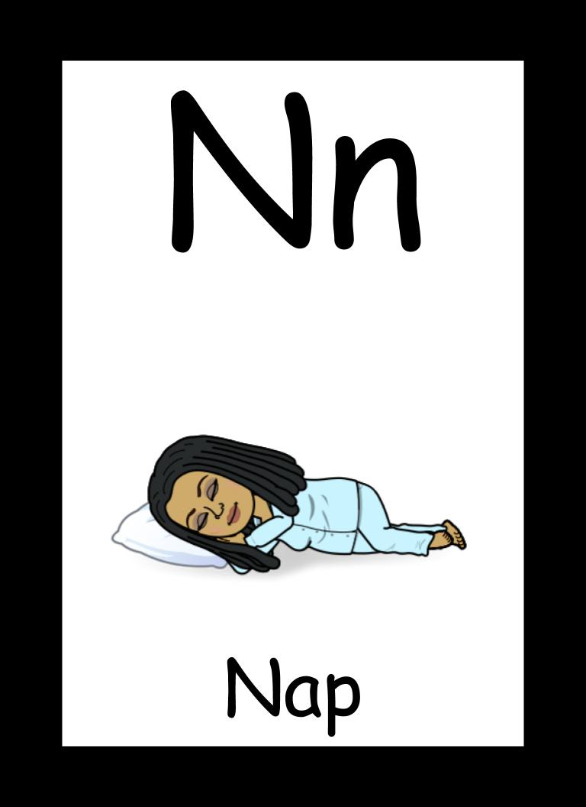
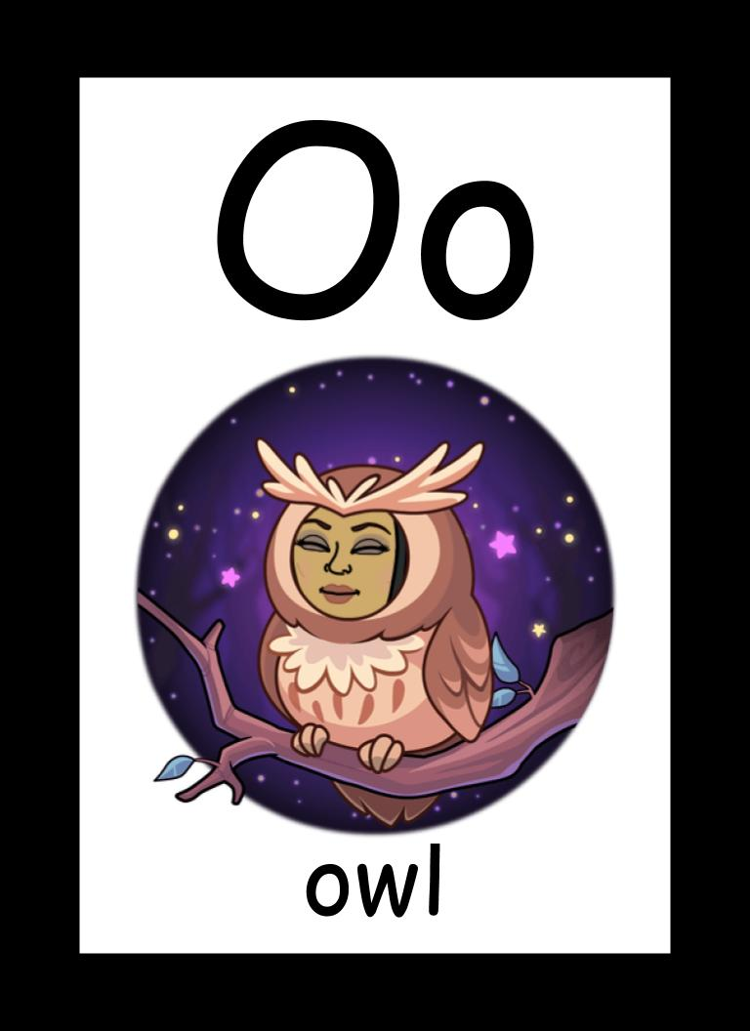
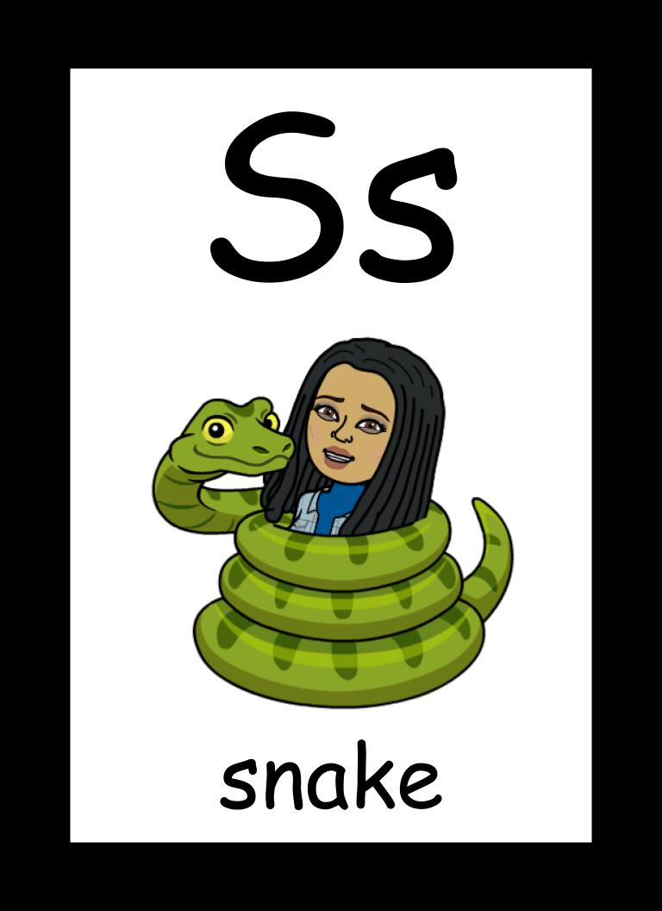
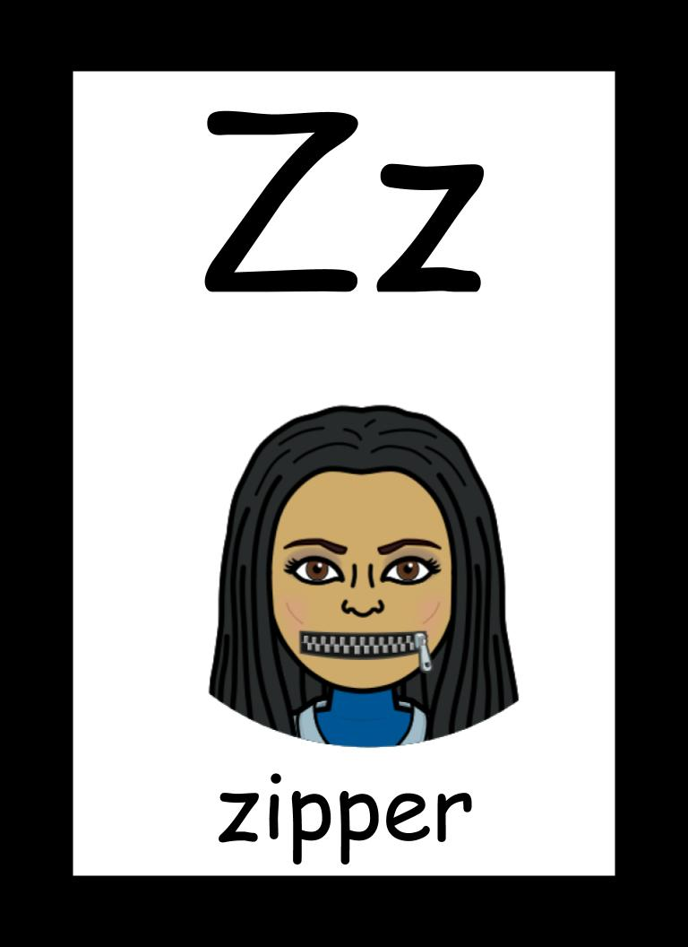
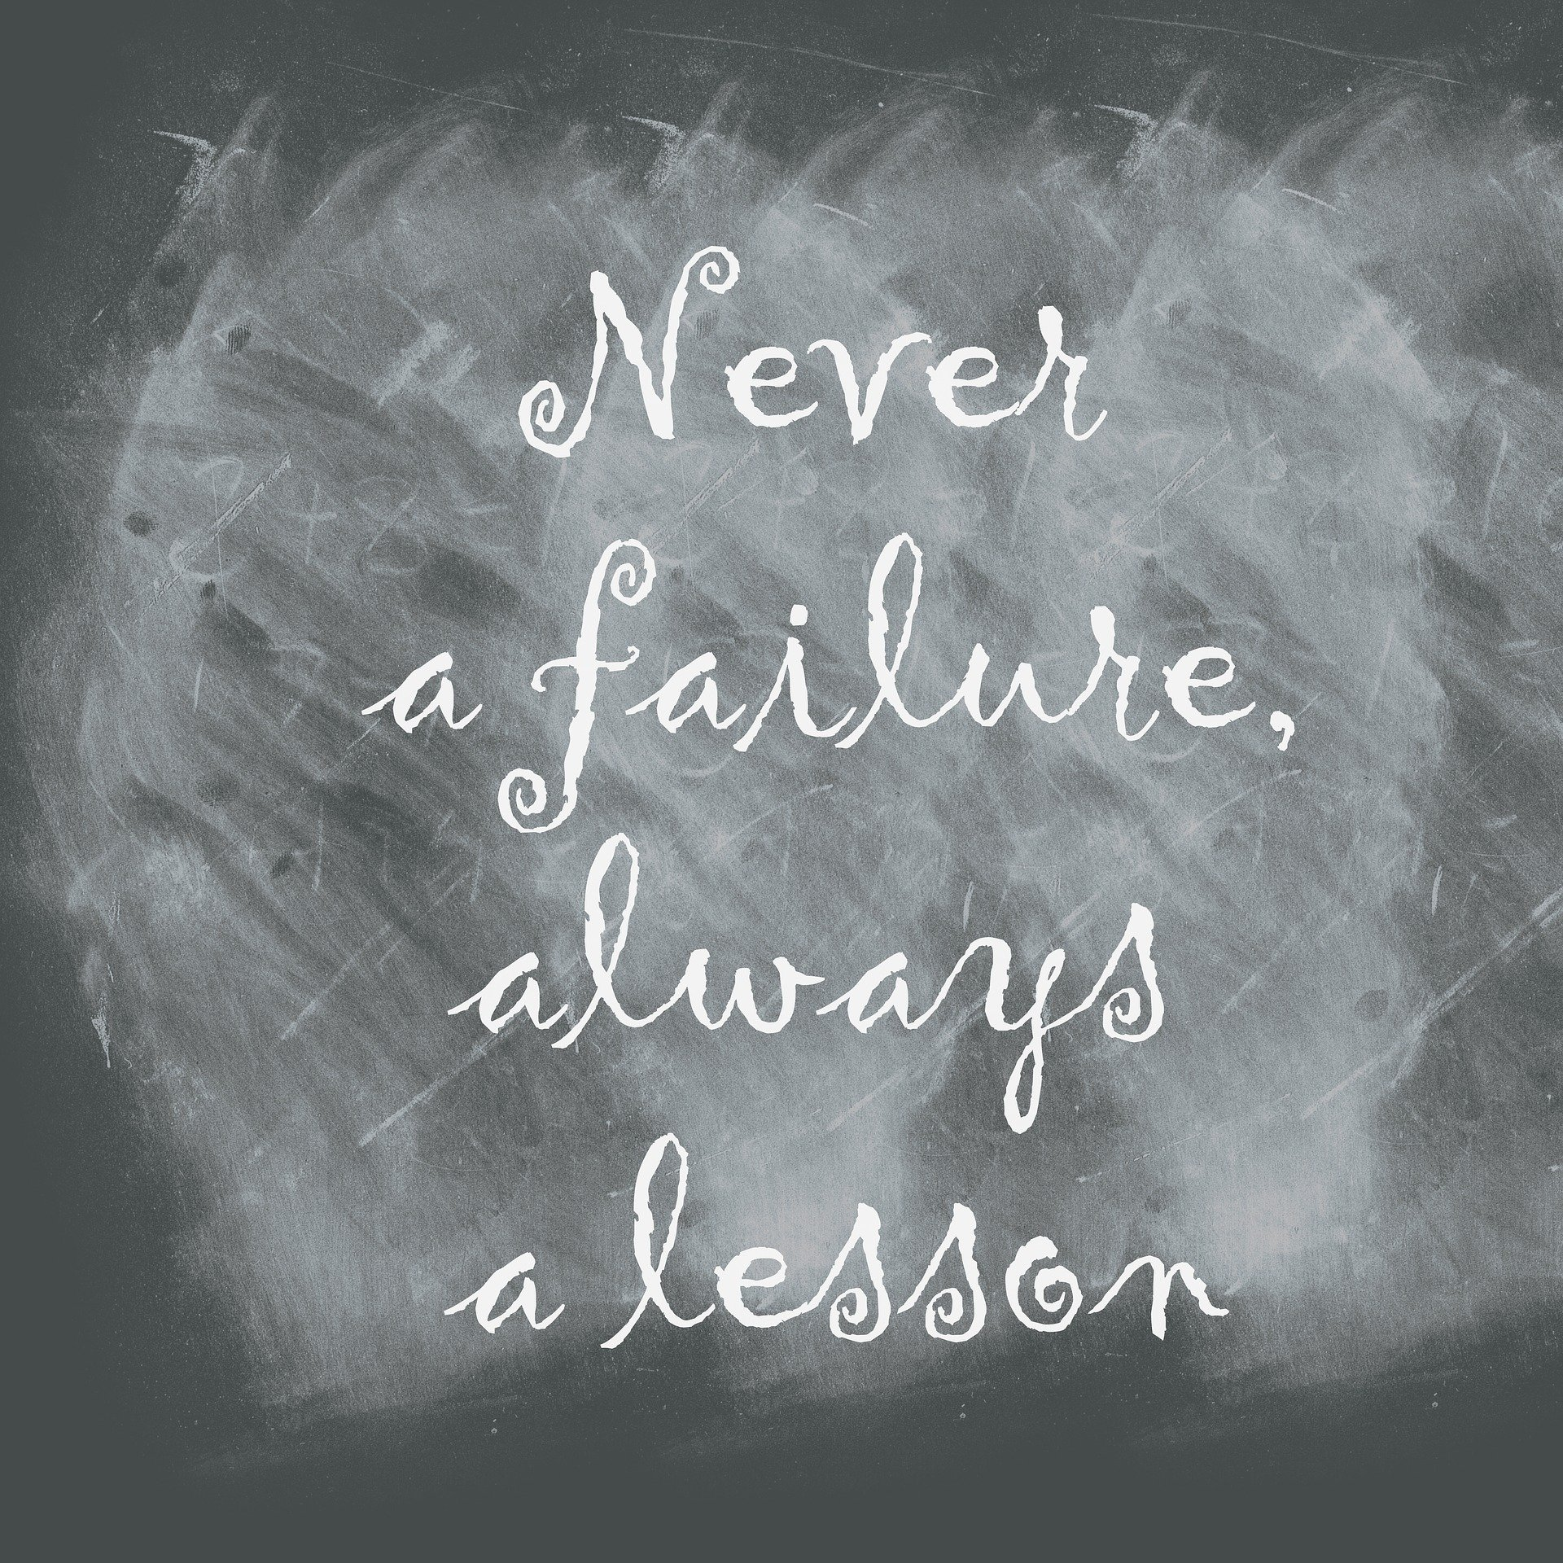
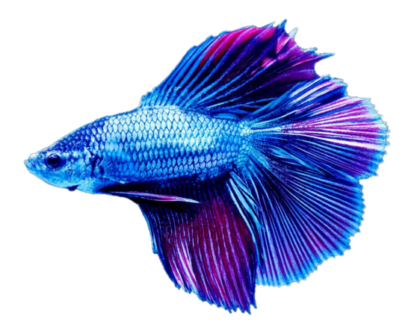
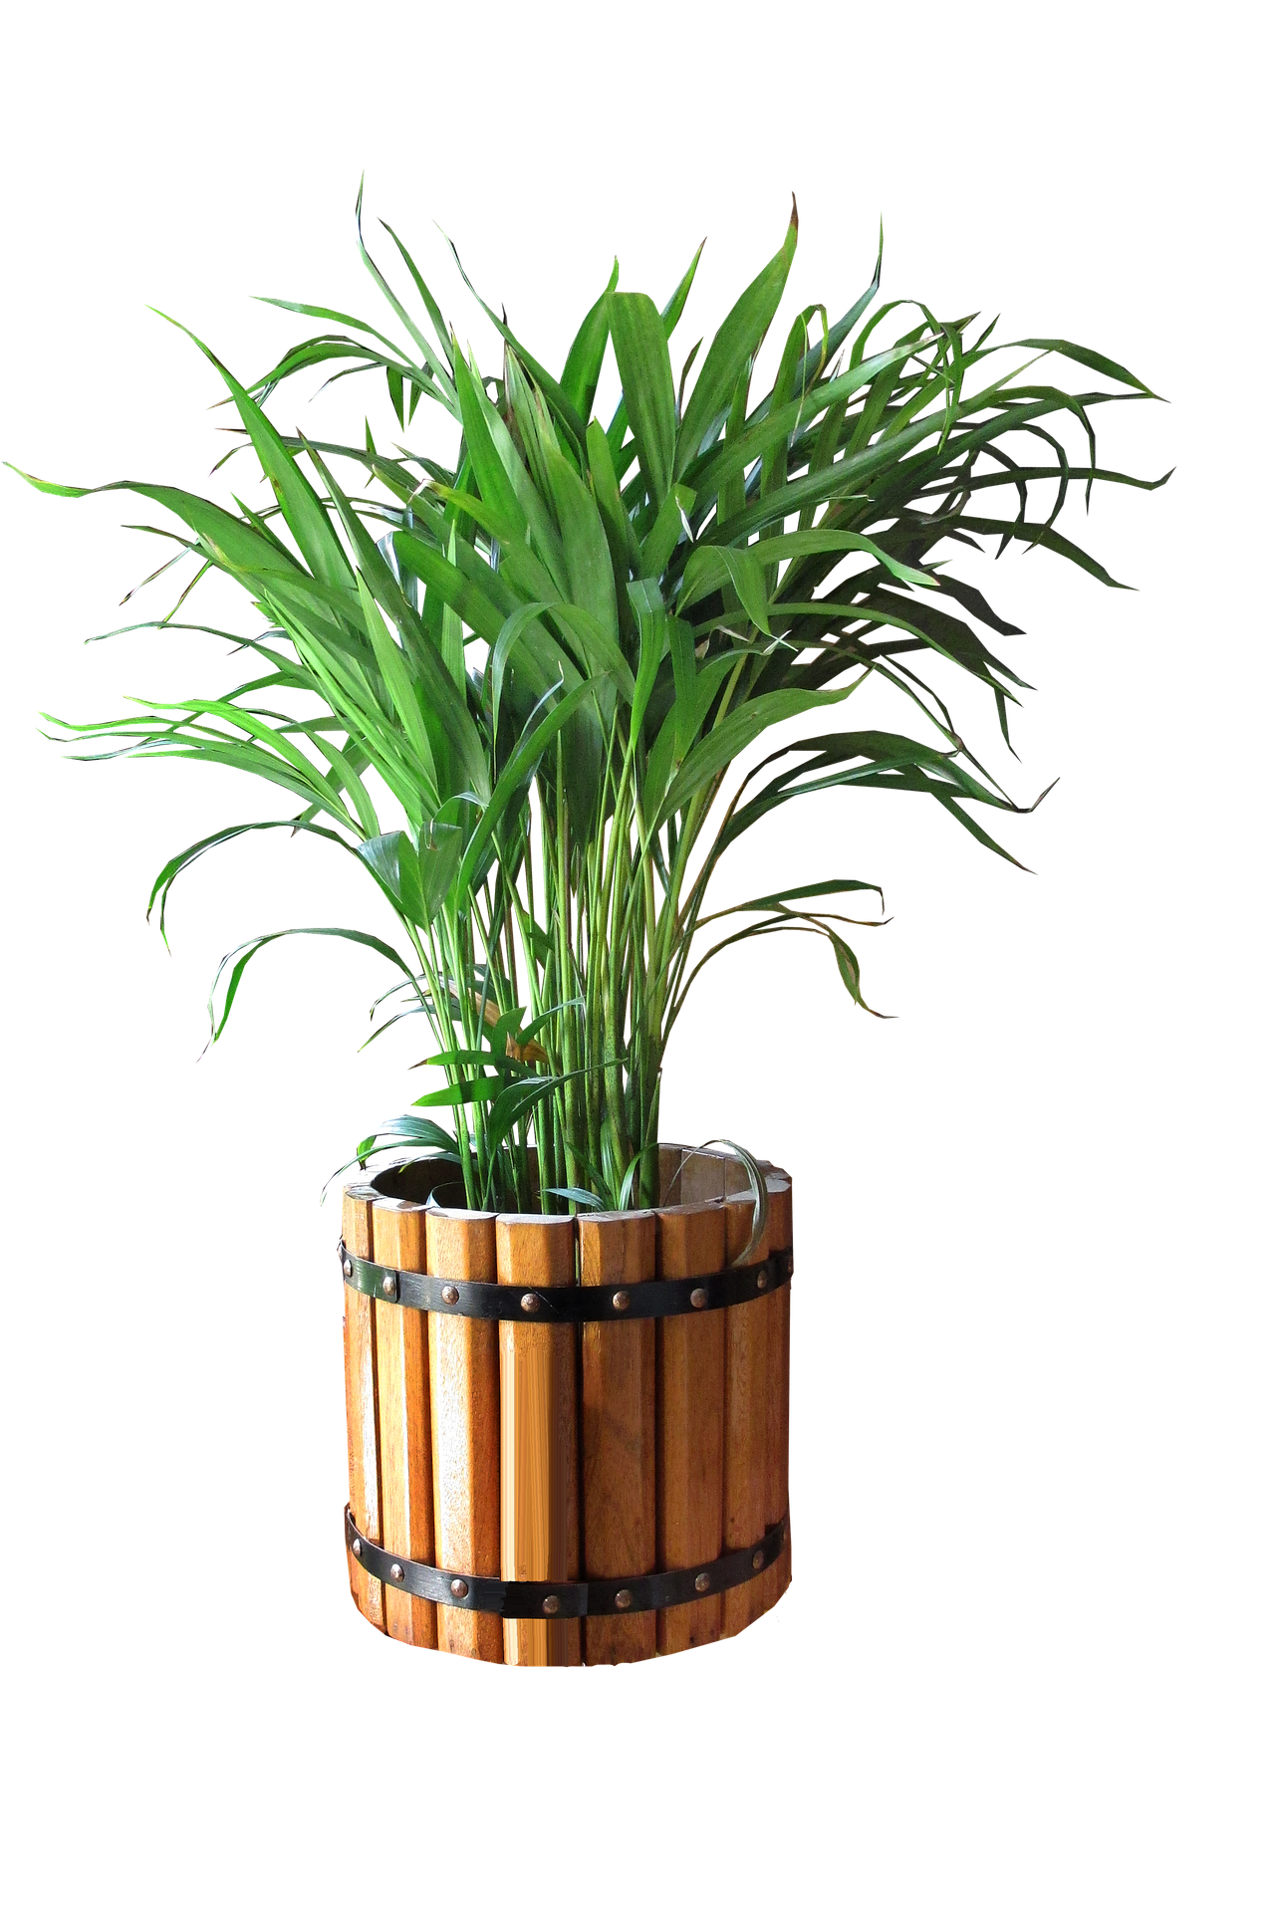
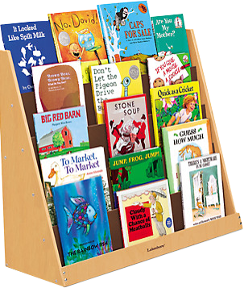

Slide 3
Find something
that is Green.
Mission #1

Slide 5
Find something
that is alive.
Mission #2

Slide 7
Find something
that is fluffy.
Mission #3

Slide 9
Find our virtual
classroom pet.
Mission #5

Slide 11
Find the first letter
of your name.
Mission #6

Slide 13
Find your
teacher
Ms. Eason.
Mission #7

Slide 15
Mission Accomplished!!!
Way to go Scholars!!

